Slide 1
Chapter 9
Introducing Microsoft Office 2010

Slide 2
Learning Objectives
Start Office programs and explore common elements
Use the Ribbon
Work with files
Use the Clipboard
Get Help
Exit Office programs

Slide 3
Microsoft Office
A collection of Microsoft programs.
The most commonly used programs include Word, Excel, Access, and PowerPoint.
Office is available in many suites, each of which contains a different combination of these programs.
Office Home and Student
Office Home and Business
Office Professional

Slide 4
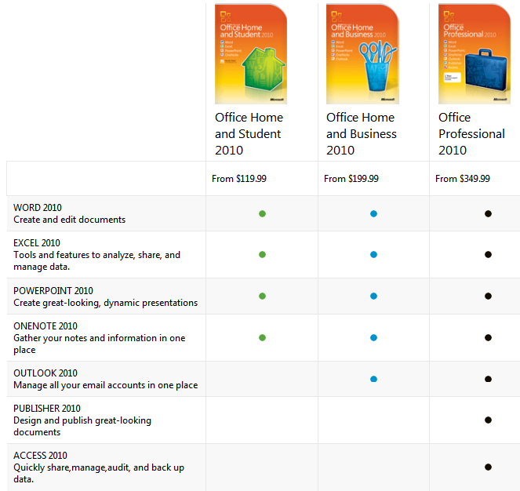
Microsoft Office

Slide 5
Starting Office programs and exploring common elements
Topics Covered:
Starting Office Programs
Examining Common Elements
Switching Between Open Programs and Files
Zooming
Scrolling

Slide 6
Starting Office Programs
All Office programs have common elements.
You can start any Office program from the Start menu on the taskbar.
You can have more than one Office program open at once.
Please start Microsoft Word and Excell

Slide 7
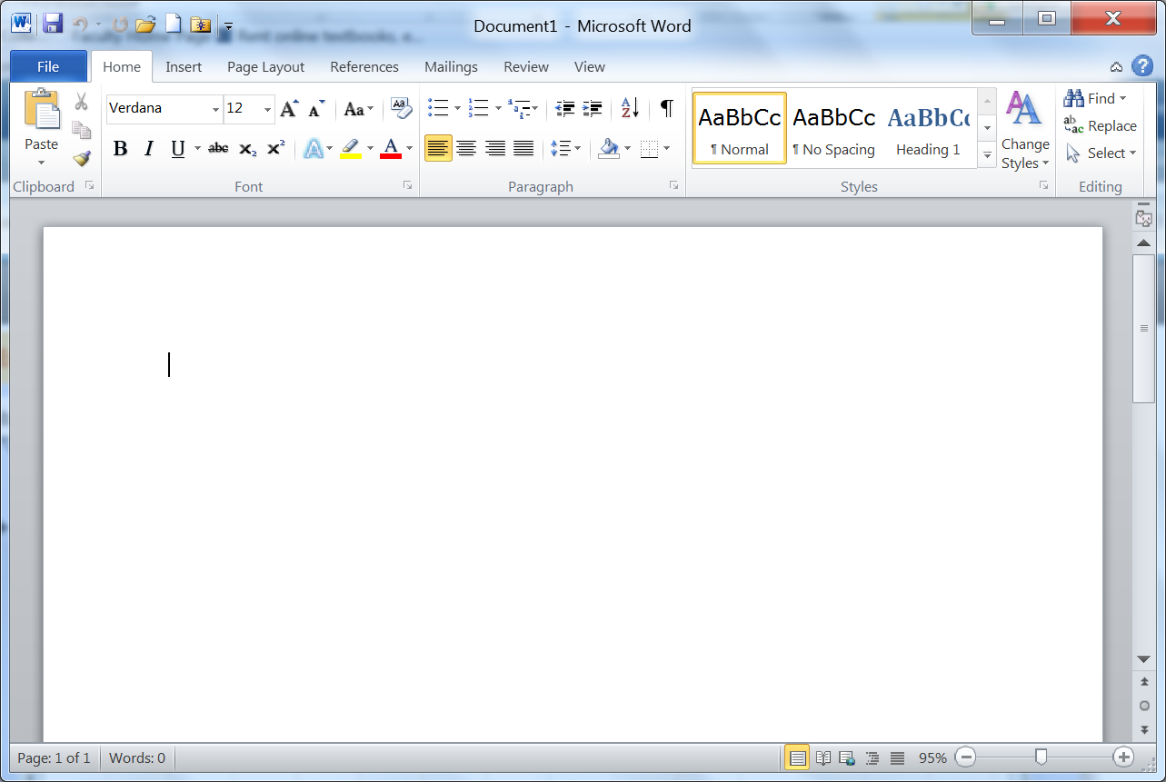
Exploring Common Elements
Quick Access Tool Bar – provides access to commonly used commands
Windows Sizing buttons
Close button
Title Bar
File tab – provides access to document-level features and program settings
Help button – opens the help window for that program
Home tab – Contains buttons to access the most commonly used commands
Ribbon– provides access to the main set of commands organized by task into tabs and groups
Workspace– Displays the file you are working on.
Zoom controls – Magnifies or shrinks the content displayed in the workspace.
View buttons – changes how a file is viewed in the workspace.
Status bar – provides information about program, open file, or current task as well as the view button and zoom controls

Slide 8
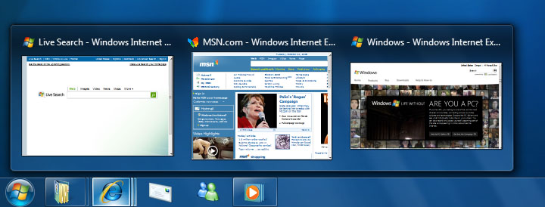
Switching Between Open Programs and Files
When two or more programs are running or two files within the same program are open, you can use the program buttons on the taskbar to switch from one program or file to another.
When you point to a program button, a thumbnail of each open window in that program is displayed.

Slide 9
Zooming
You can zoom in to get a closer look at the content of an open document, worksheet, slide, or database report.
You change the zoom level by using the zoom controls at the right end of the status bar, or by using buttons in the Zoom group on the View tab on the Ribbon.

Slide 10

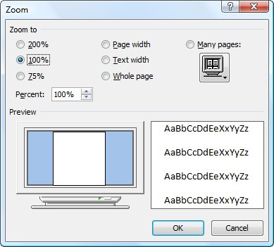
Zoom Controls
Zoom level button
Zoom out button
Zoom slider
Zoom in button
When you click on the Zoom level button the Zoom level dialog box opens

Slide 11
Scrolling
To change which area of the workspace is visible in the program window, you can use the scroll bars.
Scroll bars appear in Office program windows then the workspace is taller or wider than the window.

Slide 12
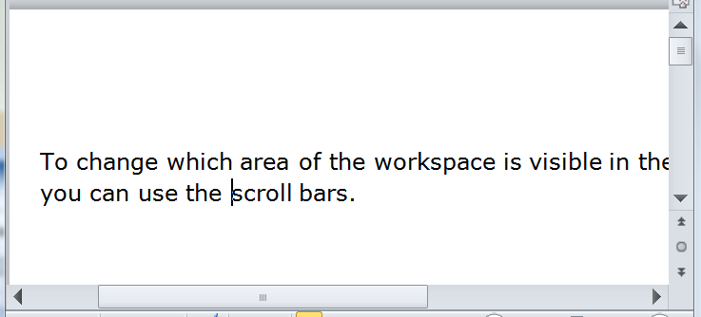
Scrolling
Up scroll arrow
Scroll box in vertical scroll bar
Scroll box in horizontal scroll bar
Down scroll arrow
Left scroll arrow
Right scroll arrow

Slide 13

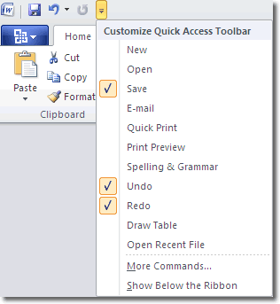
Quick Access Tool Bar
When you click on the Customize Quick Access Tool bar down arrow the following list appears

Slide 14
Using the Ribbon
Topics Covered:
Switching Tabs
Using Buttons
Using Galleries and Live Preview
Using Dialog Boxes
Using Task Panes
Displaying Contextual Tabs
Using the Mini Tool Bar

Slide 15
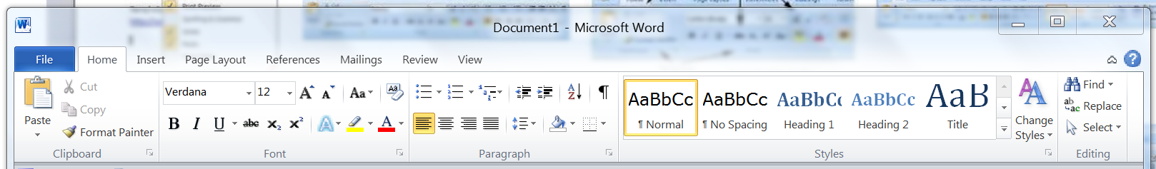
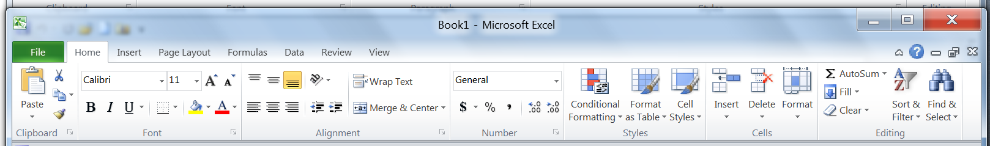
Using the Ribbon
The Ribbon contains the buttons that you click to perform tasks.
The Ribbon is organized into tabs. Each tab has buttons related to particular activities.

Slide 16
Using the Ribbon
Backstage view provides access to file-level features
In Backstage view, the left pane is called the navigation bar and contains commands and tabs.

Slide 17
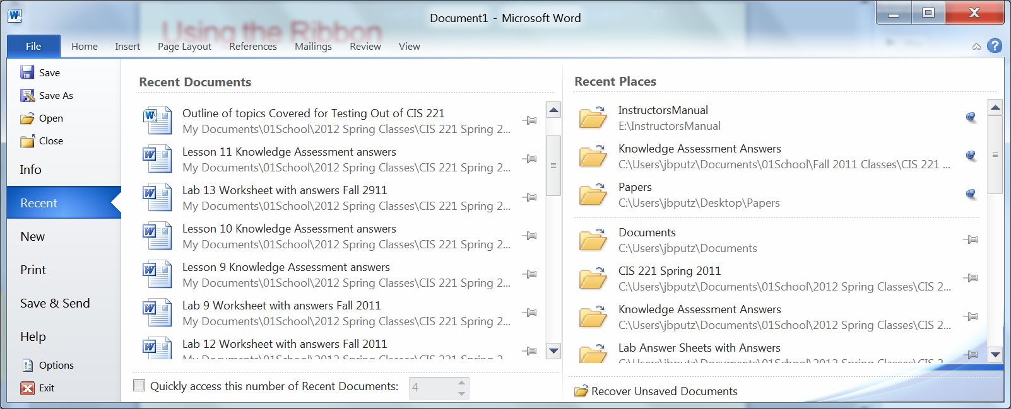
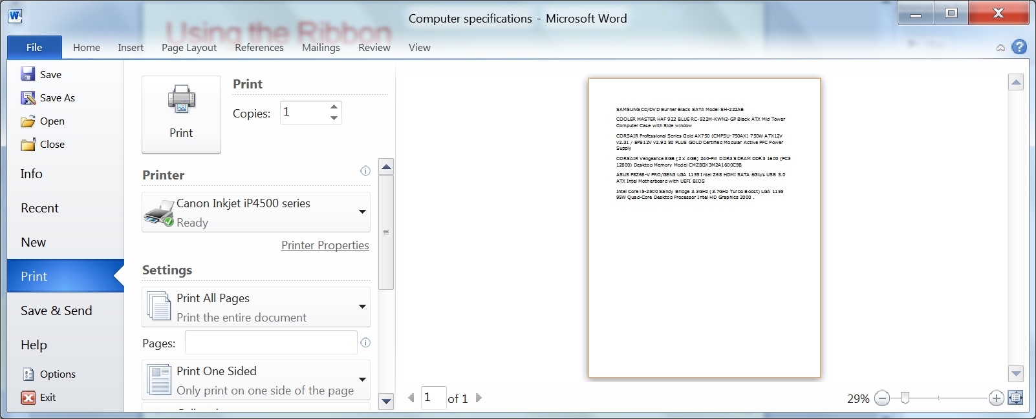
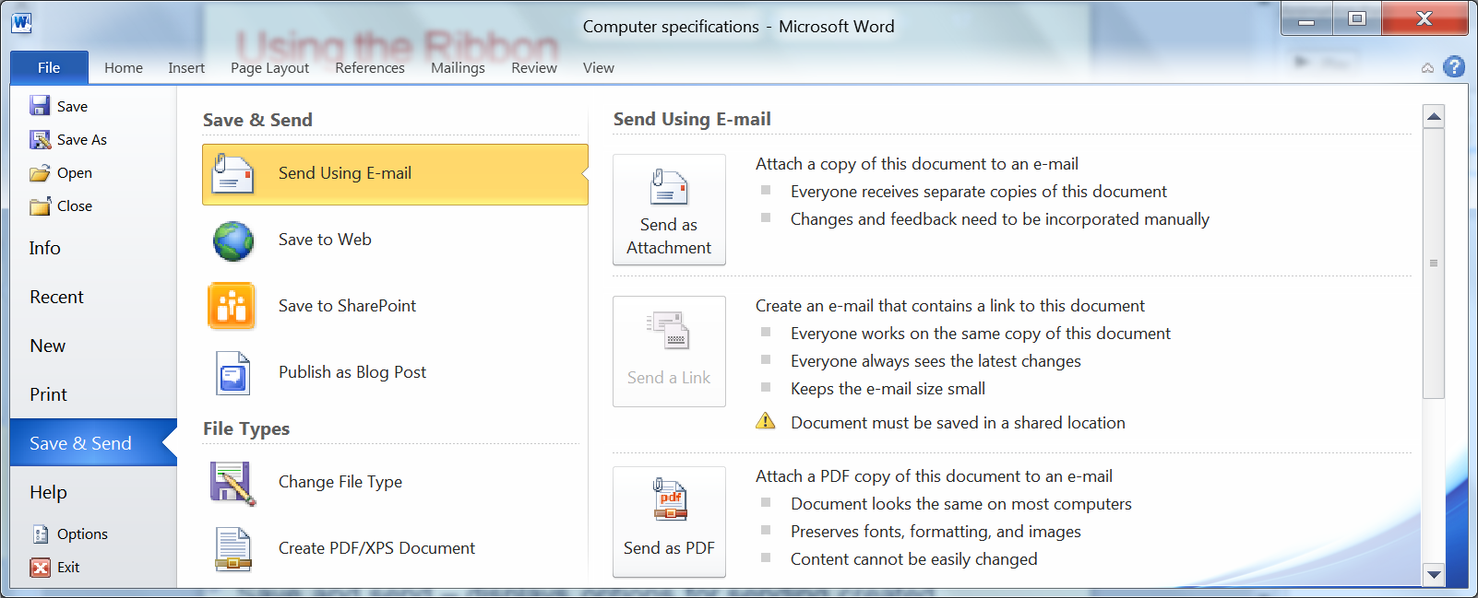
Using the Ribbon
When you first click on file tab it will open with the Recent selected.
Print – shows printer settings
Save and send – displays options for sending created documents

Slide 18
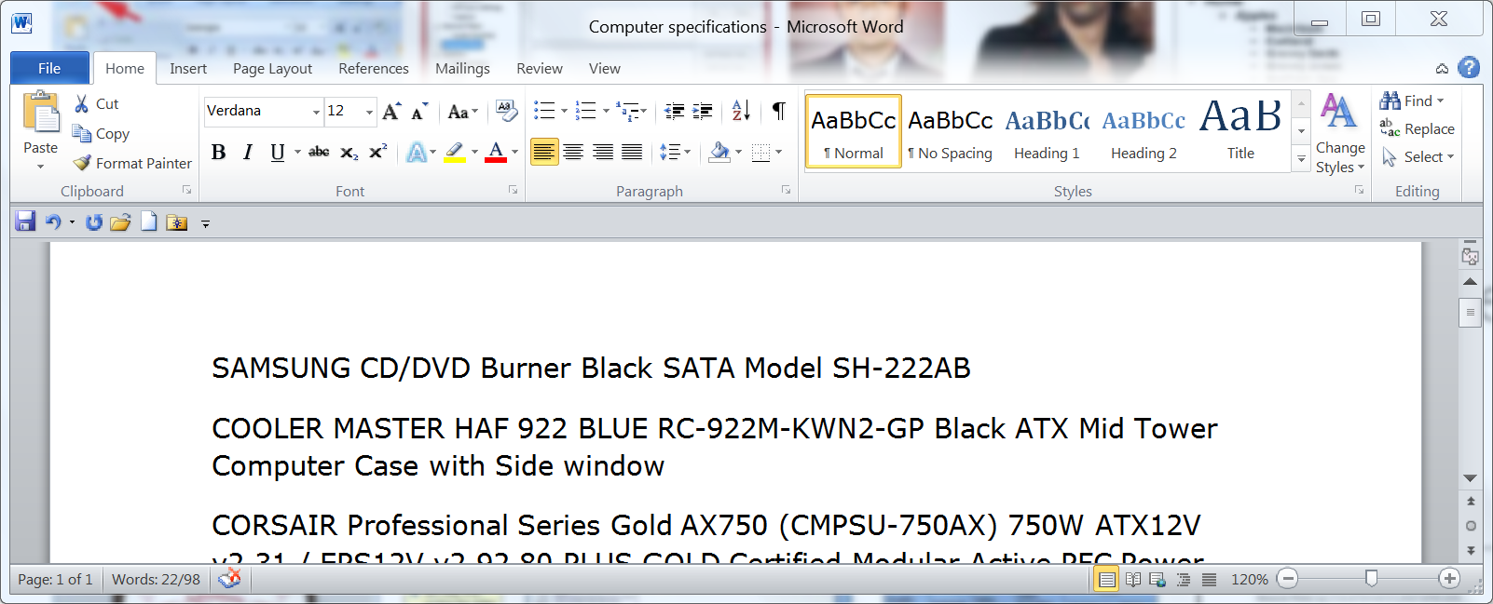
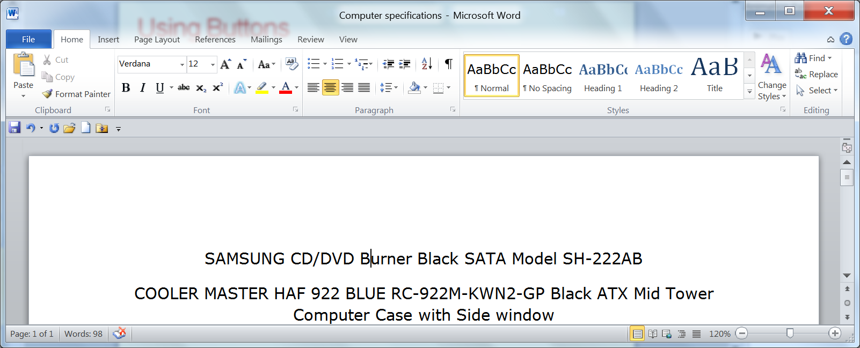
Using Buttons
Some buttons are toggle buttons: one click turns the feature on and the next click turns the feature off.

Slide 19
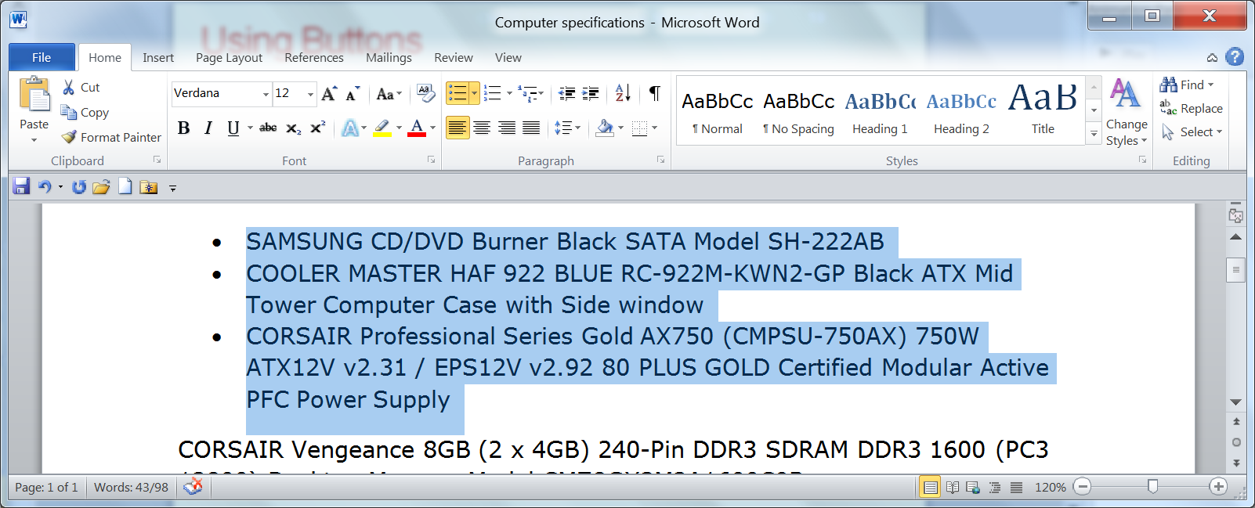
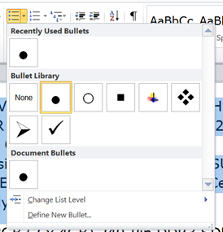
Using Buttons
Some buttons have two parts: a button that executes the default command, and an arrow that opens a menu of all the commands or options available for that command.

Slide 20
Using Galleries and Live Preview
A gallery is a menu or grid that shows visual representations of the options available for a button.
When you point to an option in a gallery, Live Preview shows the results that would occur in your file if you clicked that option.

Slide 21
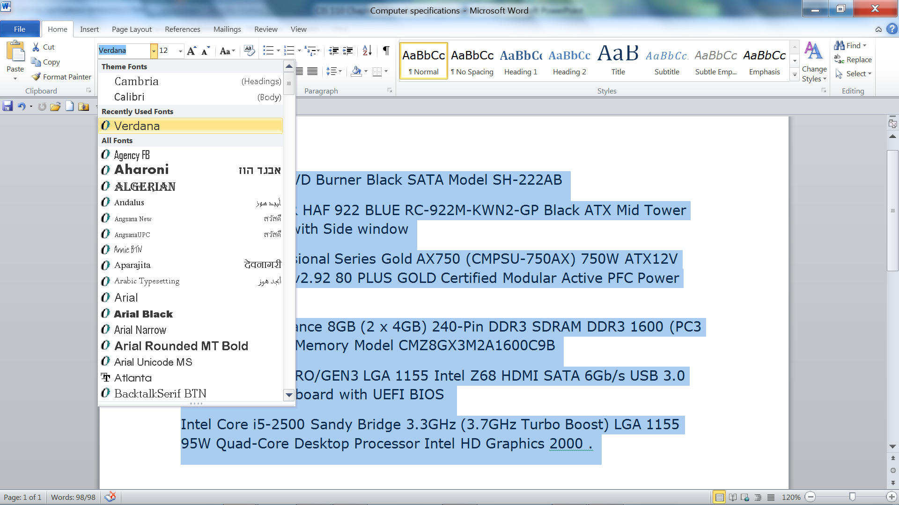
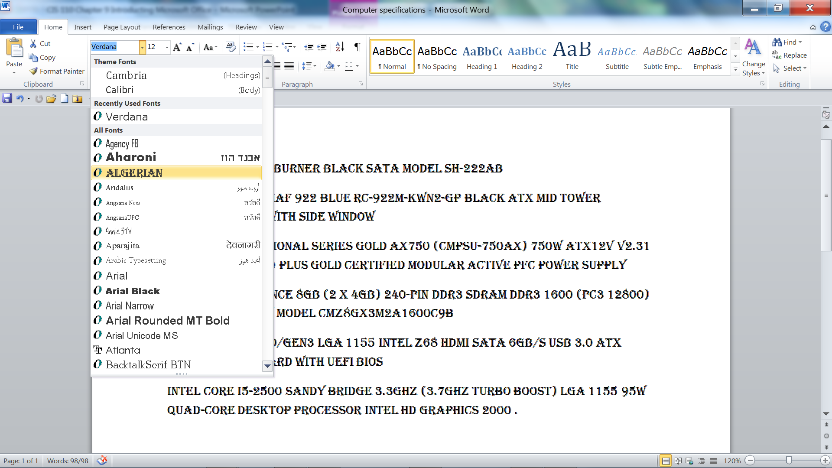
Using Galleries and Live Preview

Slide 22

Using Dialog Boxes
A dialog box is a window that opens on top of the program window in which you enter or choose settings for performing a task.
Many of the groups on the Ribbon tabs have a small button in their right corners. This is a Dialog Box Launcher

Slide 23
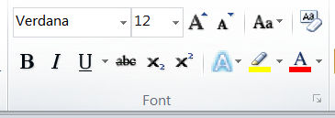
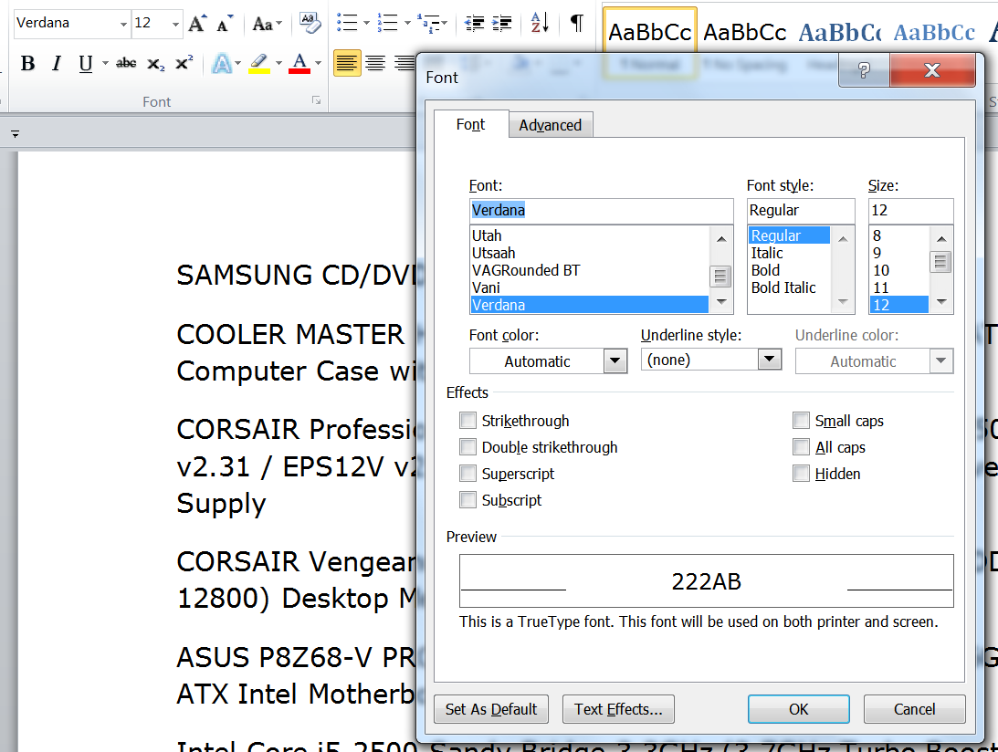
Using Dialog Boxes

Slide 24
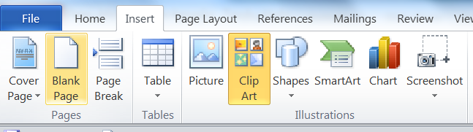
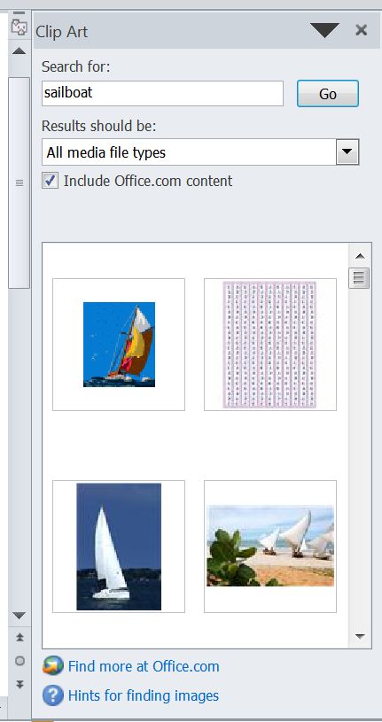
Using Task Panes
A task pane is a narrow window that appears to the left or right of the document window to help you navigate through a complex task or feature.

Slide 25
Displaying Contextual Tabs
A contextual tab is a tab on the Ribbon that contains commands related to a specific type of object or activity.
An object is anything in a document that can be manipulated as a whole, such as a table, a picture, a shape, a chart, or an equation.

Slide 26
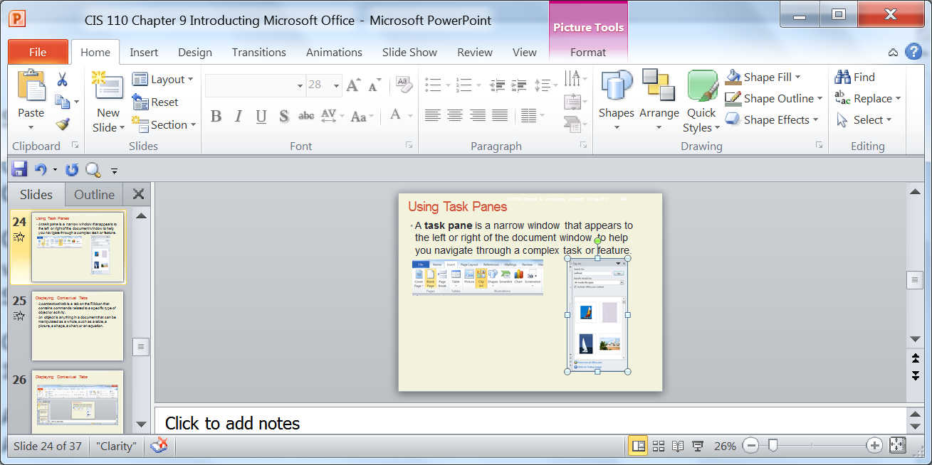
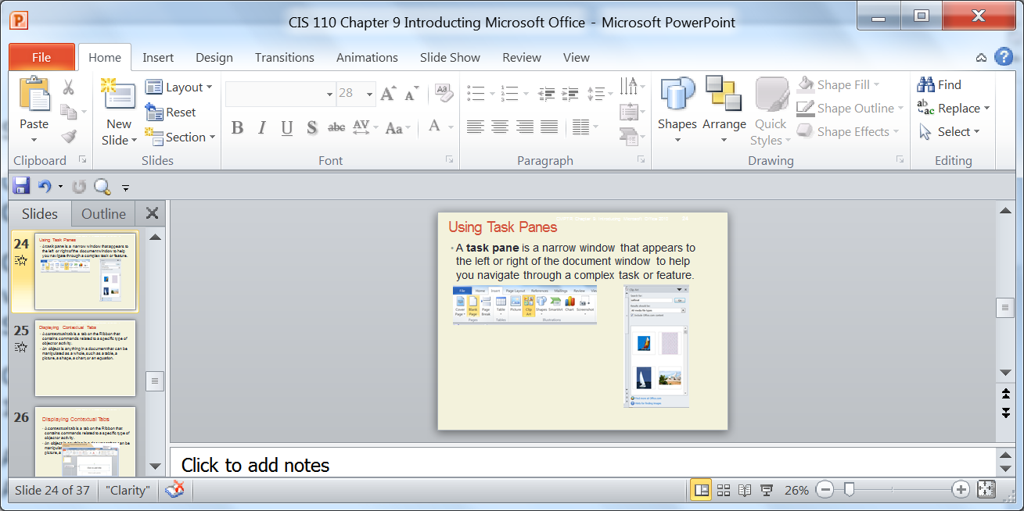
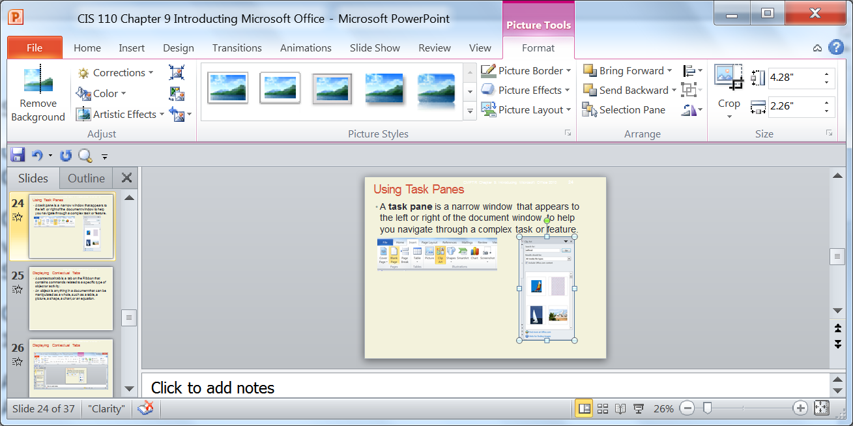
Displaying Contextual Tabs

Slide 27



Using the Mini Toolbar
The Mini toolbar contains buttons for the most commonly used formatting commands, such as font, font size, styles, color, alignment, and indents.
To access mini toolbars select the text
Point to the mini toolbar
Select the formatting command.

Slide 28
Working with Files
Topics Covered:
Saving a File
Closing a File
Opening a File

Slide 29
Saving a Files
The most common tasks you perform in any Office program are to create, open, save, and close files.
The first time you save a file, you need to name it.
This file name includes a title you specify and a file extension assigned by Office to indicate the file type.
Each file name ends with a file extension, which is a period followed by several characters that Office adds to your descriptive title to identify the program in which that file was created.

Slide 30
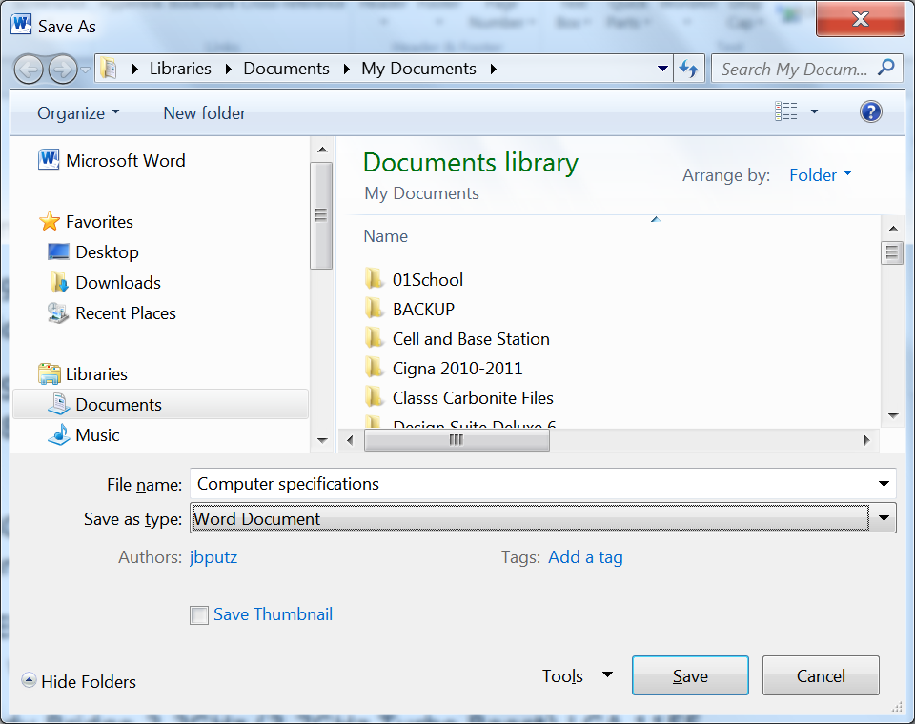
Saving a Files
List of Folders and files in the selected folder (in this case the My Documents folder)
Descriptive file name
If your computer is configured to file extensions ( in this case .docx it will appear after the name.

Slide 31
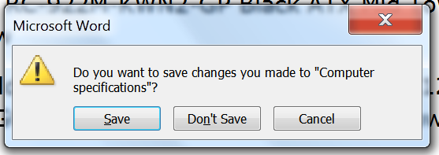
Closing a File
Although you can keep multiple files open at one time, you should close any file you are no longer working on to conserve system resources as well as to ensure that you don’t inadvertently make changes to the file.
If you forget to save a file before you close a program you will be see a dialog box the following dialog box.

Slide 32
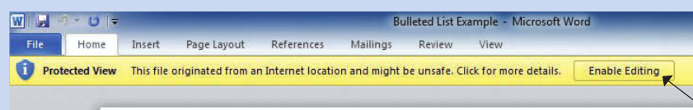
Opening a File
When you want to open a blank document, workbook, presentation, or database, you create a new file.
When you want to work on a previously created file, you must first open it.
Any file you open that was downloaded from the Internet, accessed from a shared network, or received as an email attachment might open in Protected View.
Protected View: A view of a file in an Office program in which you can see the files contents, but cannot edit, save, or print them until you enable editing.

Slide 33
Using the Clipboard
The Clipboard is a temporary storage area in Windows on which text or other objects are stored when you copy or cut them.

Slide 34
Using the Clipboard
To copy text or an object, you select it, and then use the Copy command, of the key combination Ctrl+c to place a copy of it on the Clipboard
If you want to move text from one location and paste it somewhere else, you first need to cut it—that is,
remove it from the original location and place it on the Clipboard using the Cut command or the key combination Ctrl+x.
Once something is on the Clipboard, you can then paste it anywhere you want in the current document or in another Office document—that is, you insert a copy of the text or object on the Clipboard somewhere in the document.
You can use the paste command or the key combination Ctrl+v

Slide 35
Getting Help
If you don’t know how to perform a task or want more information about a feature, you can turn to Office itself for information on how to use it. This information is referred to simply as Help.
Topics Covered:
Viewing ScreenTips
Using the Help Window

Slide 36
Viewing ScreenTips
ScreenTips - A box that appears with descriptive text about an element on the screen when you point to it.

Slide 37
Using the Help Window
The Help window provides more detailed information and allows you to access all the topics, templates, and training installed on your computer
Two ways to access help information;
Table of contents
Search

Slide 38
Using the Help Window
The Help window provides more detailed information and allows you to access all the topics, templates, and training installed on your computer with Office and on Office.com.
Office.com. - A Web site maintained by Microsoft that provides access to the latest information and additional Help resources.

Slide 39
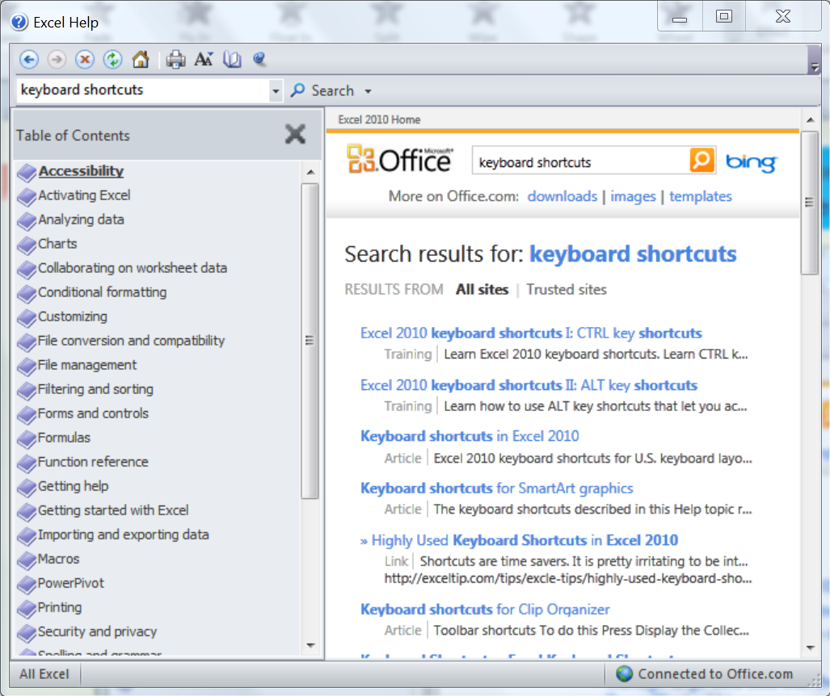
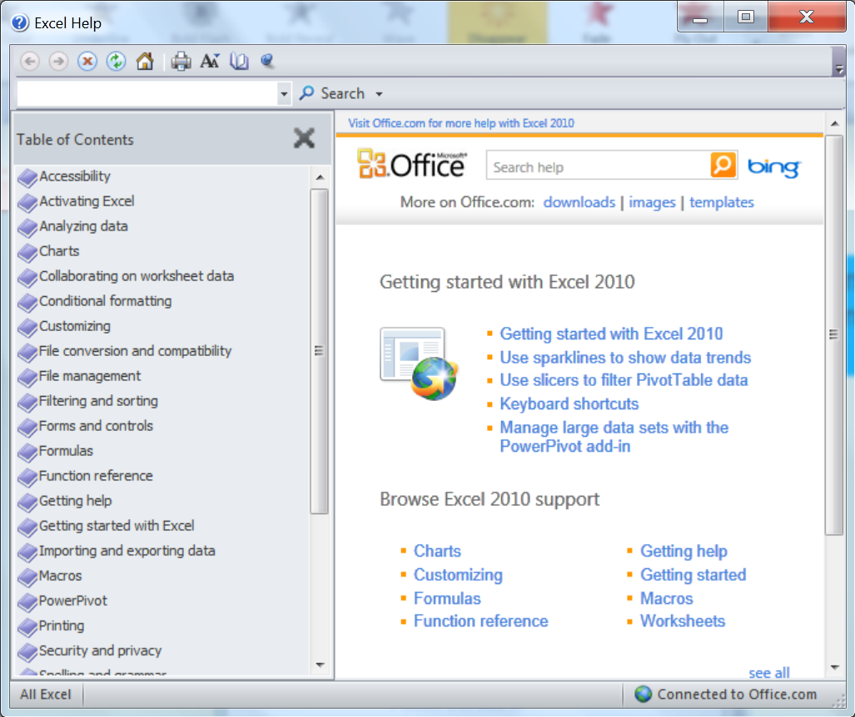
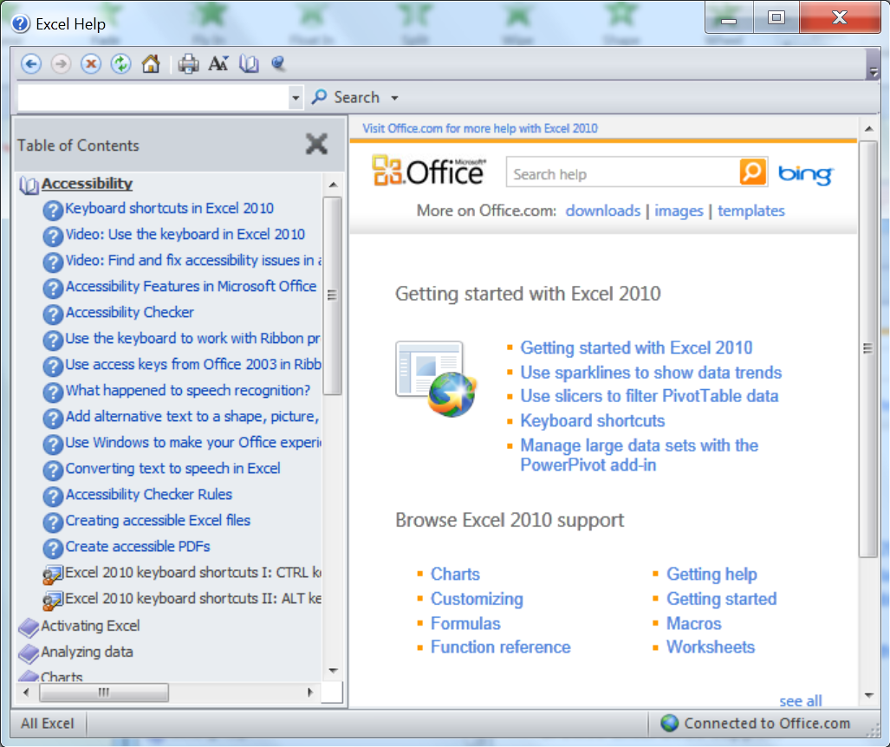
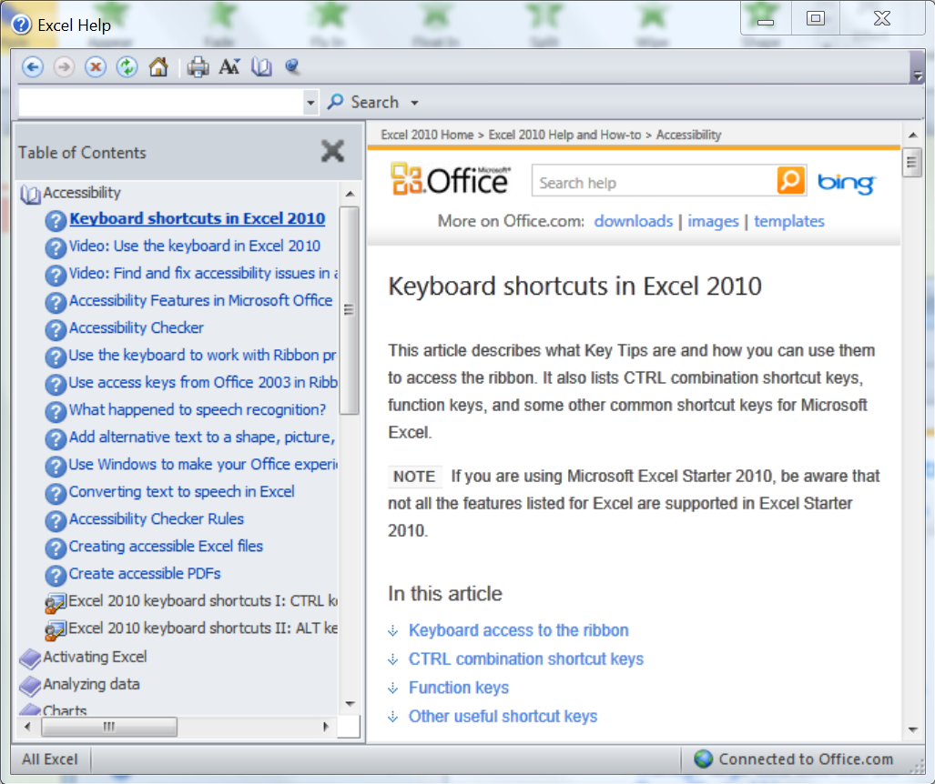
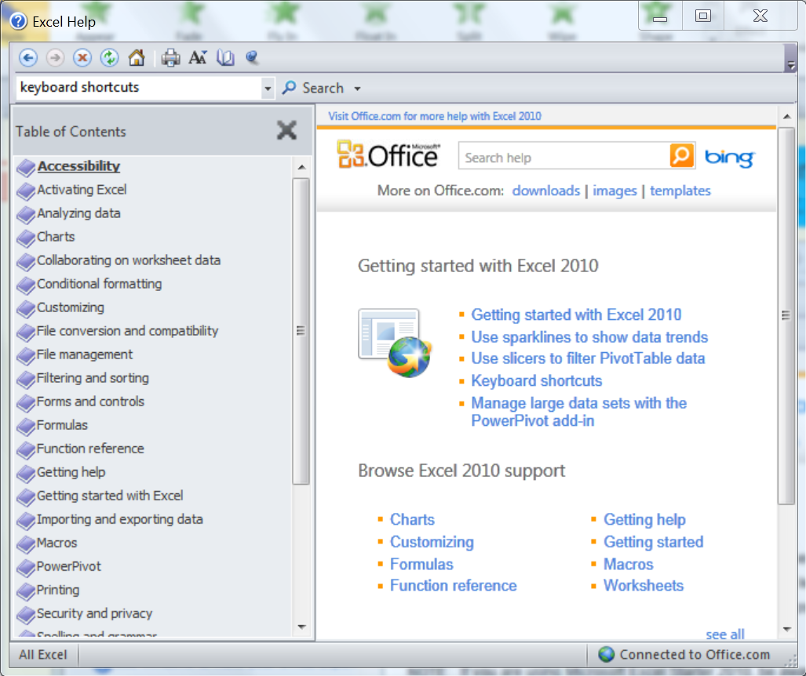
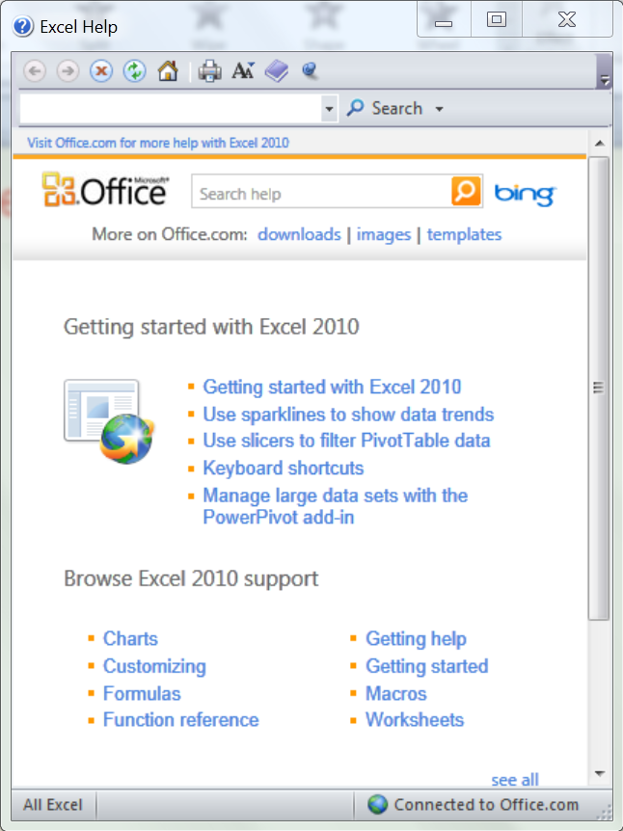
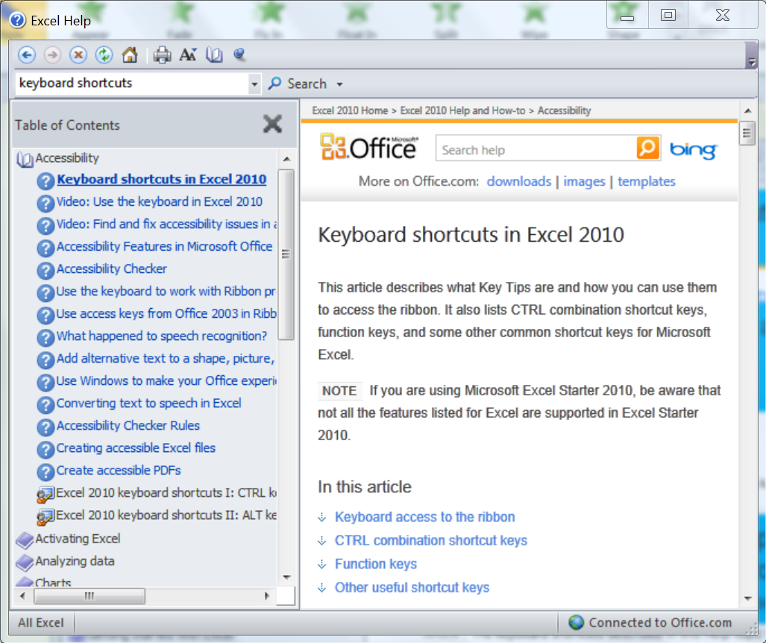
Using the Help Window
To show table of contents click on the table of contents button.
To do a search type a key word or phrase in the search box
Click on the search button. A list of topics will appear
To see topics under table of contents click on the book icon
To view the content of a specific click on it.
Note; some links will open a browser window an go to Office.com
Click on a topic link the information for that topic will appear

Slide 40
Exiting Office Programs
When you are finished working with a program, you should exit it.
Ways to exit programs:
Close button in program window title bar (when only one file is open)
Exit command in Backstage view

